Slide 1
Humanitarian Supply Chain
By Group 5
Priya Padhiyar
Ananya Pandey
Maithilee P Dharane

Slide 2
Agenda
Overview
Why Humanitarian Supply Chain?
What is Humanitarian Supply Chain?
A typical Humanitarian supply chain
Comparison of Business and Humanitarian Supply Chain
Similarities

Slide 3
Overview
The number of disasters per year have tripled over the last 50 years.
These disasters can be NATURAL or MAN-MADE.
Natural Disasters:- Hurricanes, cyclones, floods, droughts, earthquakes, volcanic eruption, epidemics, famine and food insecurity etc.
Man-made:- Wars, Refugee crisis, Terrorist Attack, Chemical leak etc..
The consequences of these events are enormous, not only in the short term with injuries, loss of life, and damaged infrastructure, but also in the long term with changes in social and economic conditions.

Slide 4
Why Humanitarian Supply Chain?
As a result, need for Humanitarian aid is increasing but the support isn’t
Disasters will further increase by 25% due to Global Warming.
Consequently, total refugees increased over 43 million.
Over 2500 disasters occurred in last 10 years.
1 billion people are hungry & 100 million urgently need food.
2 billion people below poverty line.

Slide 5
What is Humanitarian Supply Chain
Acquiring and delivering requested supplies and services at the places and times they are needed, whilst ensuring best value for money.”-International Federation of Red Cross and Red Crescent Societies
To achieve value for money Humanitarian logistics is needed which as defined by seniors at Fritz Institute is: ‘The process of planning, implementing and controlling the efficient, cost-effective flow of and storage of goods and materials as well as related information, from point of origin to point of Consumption for the purpose of meeting the end beneficiary’s requirements.”
Notes:
People affected by disaster to whom humanitarian logisticians have to deliver aid.

Slide 6
Comparison of Business and Humanitarian Supply Chain
TOPIC | BUSINESS SCM | HUMANITARIAN SCM
Main Goal | Maximize profit | Save lives and stop sufferings.
Demand Pattern | Fairly Stable | Irregular
Supply Pattern | Mostly predictable | Donations Dependent
Flow Type | Commercial Products | Shelter, food, drugs
Lead time | Predetermined | Next to Zero
Inventory Control | Safety Stocks | Determining safety stock itself is a challenge
Delivery Network Structure | Location of Warehouse, DC’s | Ad hoc
Technology | Highly developed technology | Less technology is used
Performance measurement | Based on standard supply chain metric | Time to respond to disaster, meeting donor expectation, percentage of demand supplied

Slide 7
Similarities
Need to be responsive.
80% of Supply Chain Management is all about Logistics.
End goal of both is to satisfy their end users.
Although humanitarian and business supply chains are significantly different in their nature, they both must have proper planning, strategy and must be able to react to uncertainty.
Notes:
need to be ‘multiple, global, dynamic and temporary’ in order to be responsive on a global scale
.

Slide 8
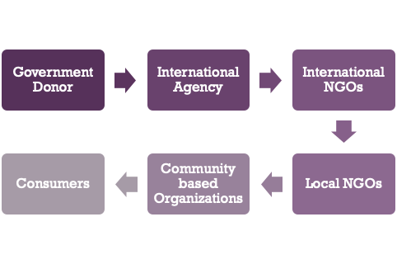
A typical Humanitarian supply chain
Notes:
DONORS CAN BE LOCAL/INTERNATIONAL/GOVERNMENT
ORGANIZATIONS CAN BE PUBLIC/PVT/COMMUNITY BASED
CONSUMERS ARE THOSE WHO REQUIRE AID
Basically flow of information, money and products is happening here also then whats the difference between the two supply chains ?

Slide 9
Five Key Elements
Human Resources
Knowledge Management
Operations & Process Management
Financial Resources
The Community
Ensuring the flow of goods (materials), information and funds

Slide 10
Drivers of Humanitarian Supply Chain
Facilities
Inventory
Transportation
Near Location of disaster
Prepositioned Stock
Air (initial 72 hrs)
Local, Ground, Sea (90-100 days)
Information
Sourcing
Pricing
Continuous Updates
Many relief efforts
Locally
Globally (availability)
Financing these efforts is done by suppliers and donors
Notes:
facility-

Slide 11

Government Donor
FEMA(Federal Emergency Management Agency):
It coordinates the federal government's role in preparing for, preventing, mitigating the effects of, responding to, and recovering from all domestic disasters, whether natural or man-made, including acts of terror.

Slide 12

International Agency
UNDP (United Nations Development Programme) : It promotes and supports disaster preparedness activities in member countries.
UNDP works in about 170 countries and territories, helping to achieve the eradication of poverty, and the reduction of inequalities and exclusion.

Slide 13

International agency cont.
WFP(World Food Programme): It is the food-assistance branch of the United Nations and the world's largest humanitarian organization addressing hunger and promoting food security.

Slide 14
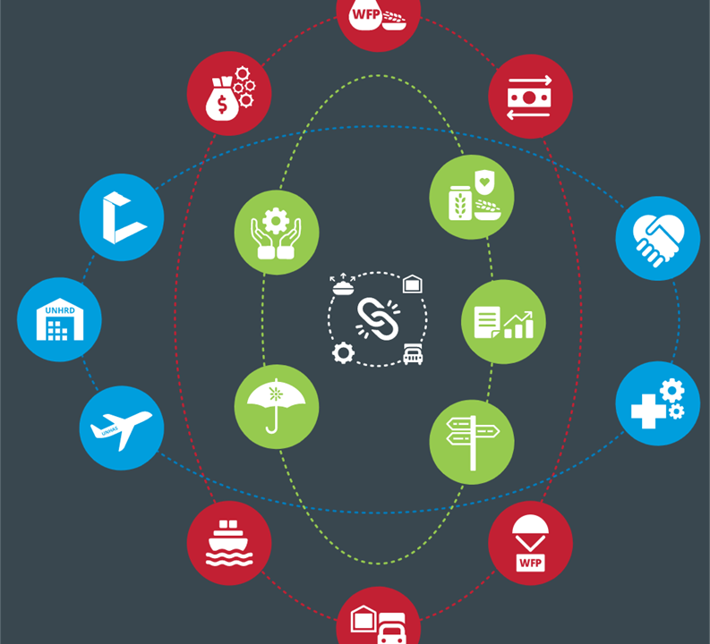
Elements of WFP Supply Chain
FOOD PROCUREMENT
GOODS & SERVICES PROCUREMENT
BUSINESS SUPPORT:
LOGISTICS CLUSTER:
UNHRD:
UNHAS:
RISK AND INSURANCE
SHIPPING:
CASH-BASED TRANSFERS & MARKETS
FOOD SAFETY AND QUALITY ASSURANCE
BILATERAL SERVICE PROVISION
PLANNING
SOLVE
NORMATIVE GUIDANCE AND COMPLIANCE
AVIATION
LOGISTICS

Slide 15
Success Stories
Swine Flu (H1N1 Virus):
Early detection and reporting of the novel virus
Functional global communications among countries and organizations
Wide sharing of viruses, genetic sequences, and related information
On-time development, production and provision of a pandemic vaccine
Increased access to antiviral drugs
Modest enactment of trade and travel restrictions
World wide support with emergency relief supplies
Conduction of pandemic preparedness exercises

Slide 16
Success Stories cont.
Gujarat Earthquake :
Proper communication and collaboration among the donors
Proper transportation to and from the affected areas
Proper distribution of supplies

Slide 17
Failure Stories
Hurricane Katrina
FEMA response to Katrina- incapability and lack of preparation to face catastrophic disaster.
No transportation for people to evacuate.
No proper communication- loss of communication between the authorities and the aid recipients.
No proper distribution of supplies- lack of warehousing and access to supplies on site.
lack of serious consideration for the disaster by the authorities- mandatory evacuation order came only after Katrina had climbed dangerously to a Category 4 and then to a Category 5.

Slide 18
Failure Stories cont.
Indian Ocean Earthquake and Tsunami:
Lack of Infrastructure- infrastructure inadequacies lead to bottlenecks, delays, and congestion at entry points to the disaster area
Lack of communication
Unsolicited and unsuitable goods
Lack of assessment
Political Pressure
Problems with financial Supply Chain

Slide 19
How to Improve Humanitarian Supply Chain
Demand Analysis:- Based on historical data and past experiences of different types of disaster, forecast the demand that may arise.
Inventory Planning and Control:- Given to the High level of Uncertainty in lead time it is important to have adequate Inventory, especially when the local supply might be very limited.
Collaboration of Organizations:- Co-ordination between the different NGOs is of utmost importance for a responsive Supply Chain.
Notes:
Many a times in order to gain media attention NGOs don't unite in providing aid which can become a hurdle.

Slide 20
Cont
Understanding regional Conditions:- Awareness of the local conditions is crucial for the success of the humanitarian operations.
Constant communication. Information from and communication with the people in the field, right where the disaster took place, is critical. Information and communication emergency systems should be built in advance.
Notes:
Arrange cultural awareness training programs to create opportunities for a given organization to meet with others that have previously worked in the region.
Arrange cultural awareness training programs to create opportunities for a given organization to meet with others that have previously worked in the region.
Arrange cultural awareness training programs to create opportunities for a given organization to meet with others that have previously worked in the region

Slide 21


